Slide 1


Slide 2
Designers
Create Players
Create Properties with unique squares potential additional (you can edit template or make own)
Look up monopoly board for ideas on how game works
When you land on go ideas include student loans are in or grant
Any ideas of your own
This will be discussed at next team meeting and ideas may be added

Slide 3
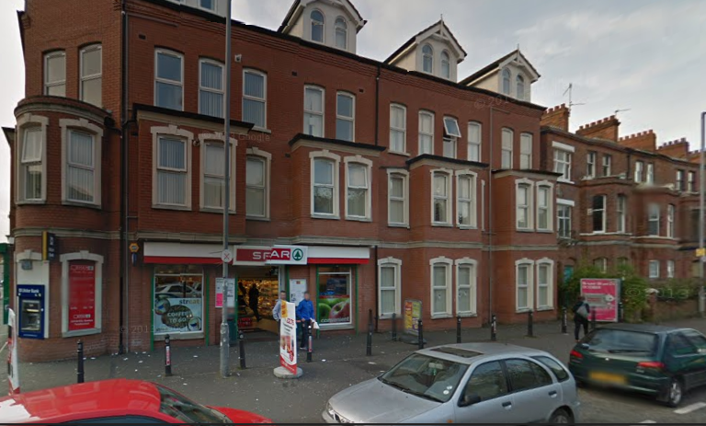
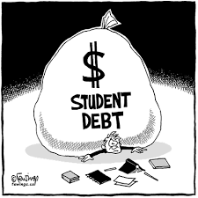
ROW 1: BOXES 1 -5
Holylands
GO
Student Loan Repayment

Slide 4
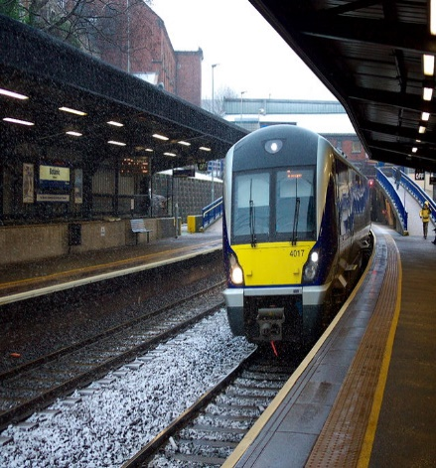
ROW 1: BOXES 6-10
Botanic Station

Slide 5
ROW 2: BOXES 1-5

Slide 6
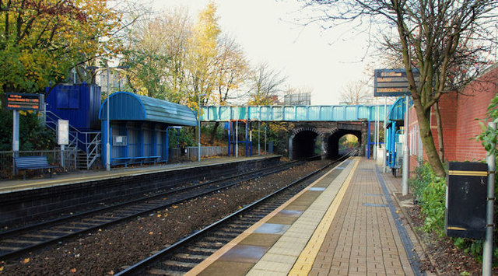
ROW 2: BOXES 6-10
City Hospital Station

Slide 7
ROW 3: BOXES 1-5

Slide 8
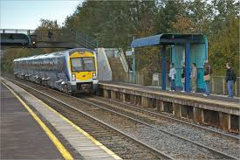
ROW 3: BOXES 6-10
Adelaide Station

Slide 9
ROW 4: BOXES 1-10

Slide 10
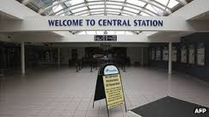
ROW 4: BOXES 6-10
Central Station
Lisburn Road
Malone Road

Slide 11
Unique Features of the Game

